Slide 1
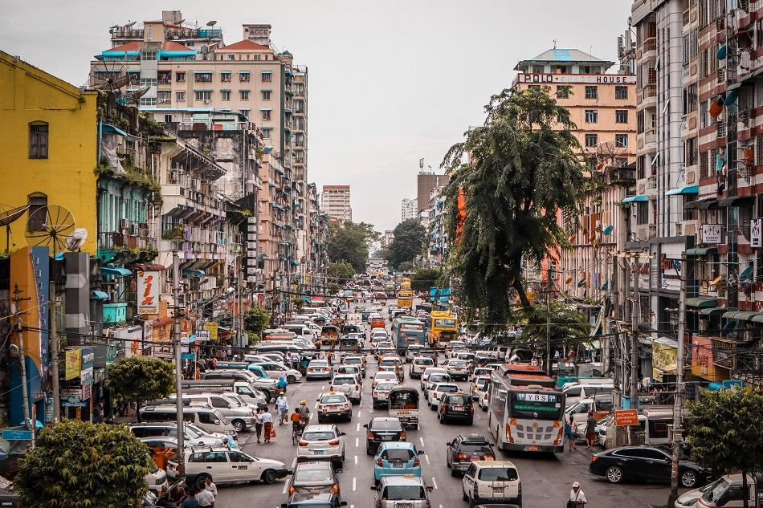
Doh Phandee Challenge
Changes in Yangon air quality by COVID 19
20th November, 2020

Slide 2
Project description
Studied changes of fine dust particles matter (PM2.5) concentrations in Yangon before and during COVID 19 times.
Visualized the results with graphs and Air Quality Index (AQI) map.
Analysed weather factors affecting on the PM2.5 concentration changes with regression model.
Predicted PM2.5 concentration changes in the future with ARIMA and HoltWinters models.

Slide 3
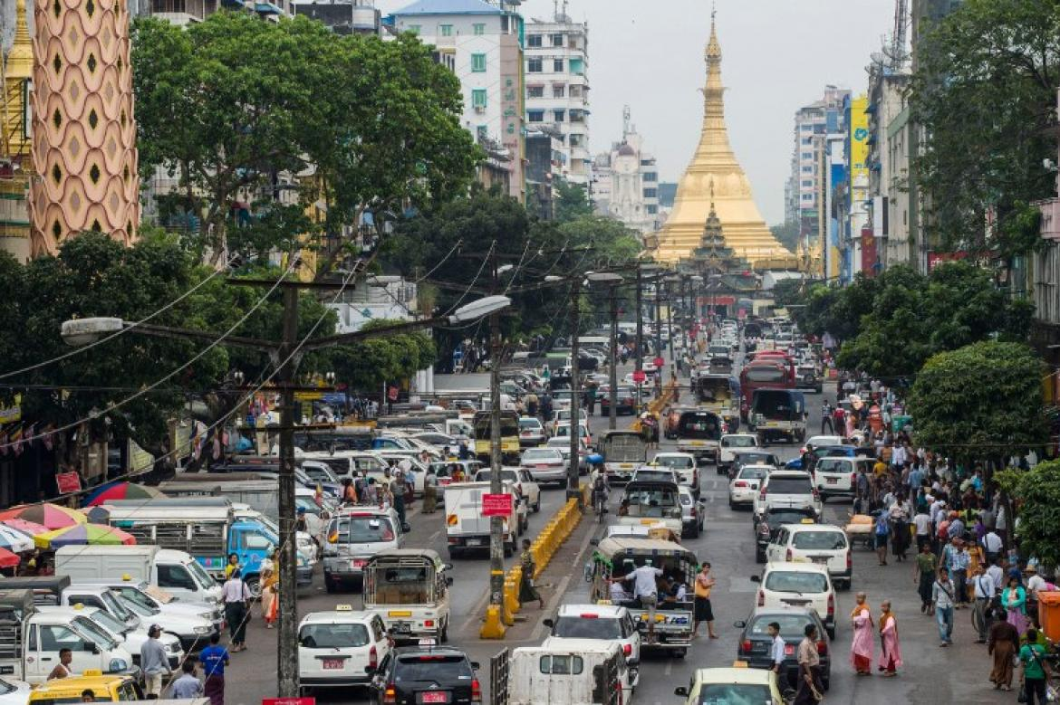
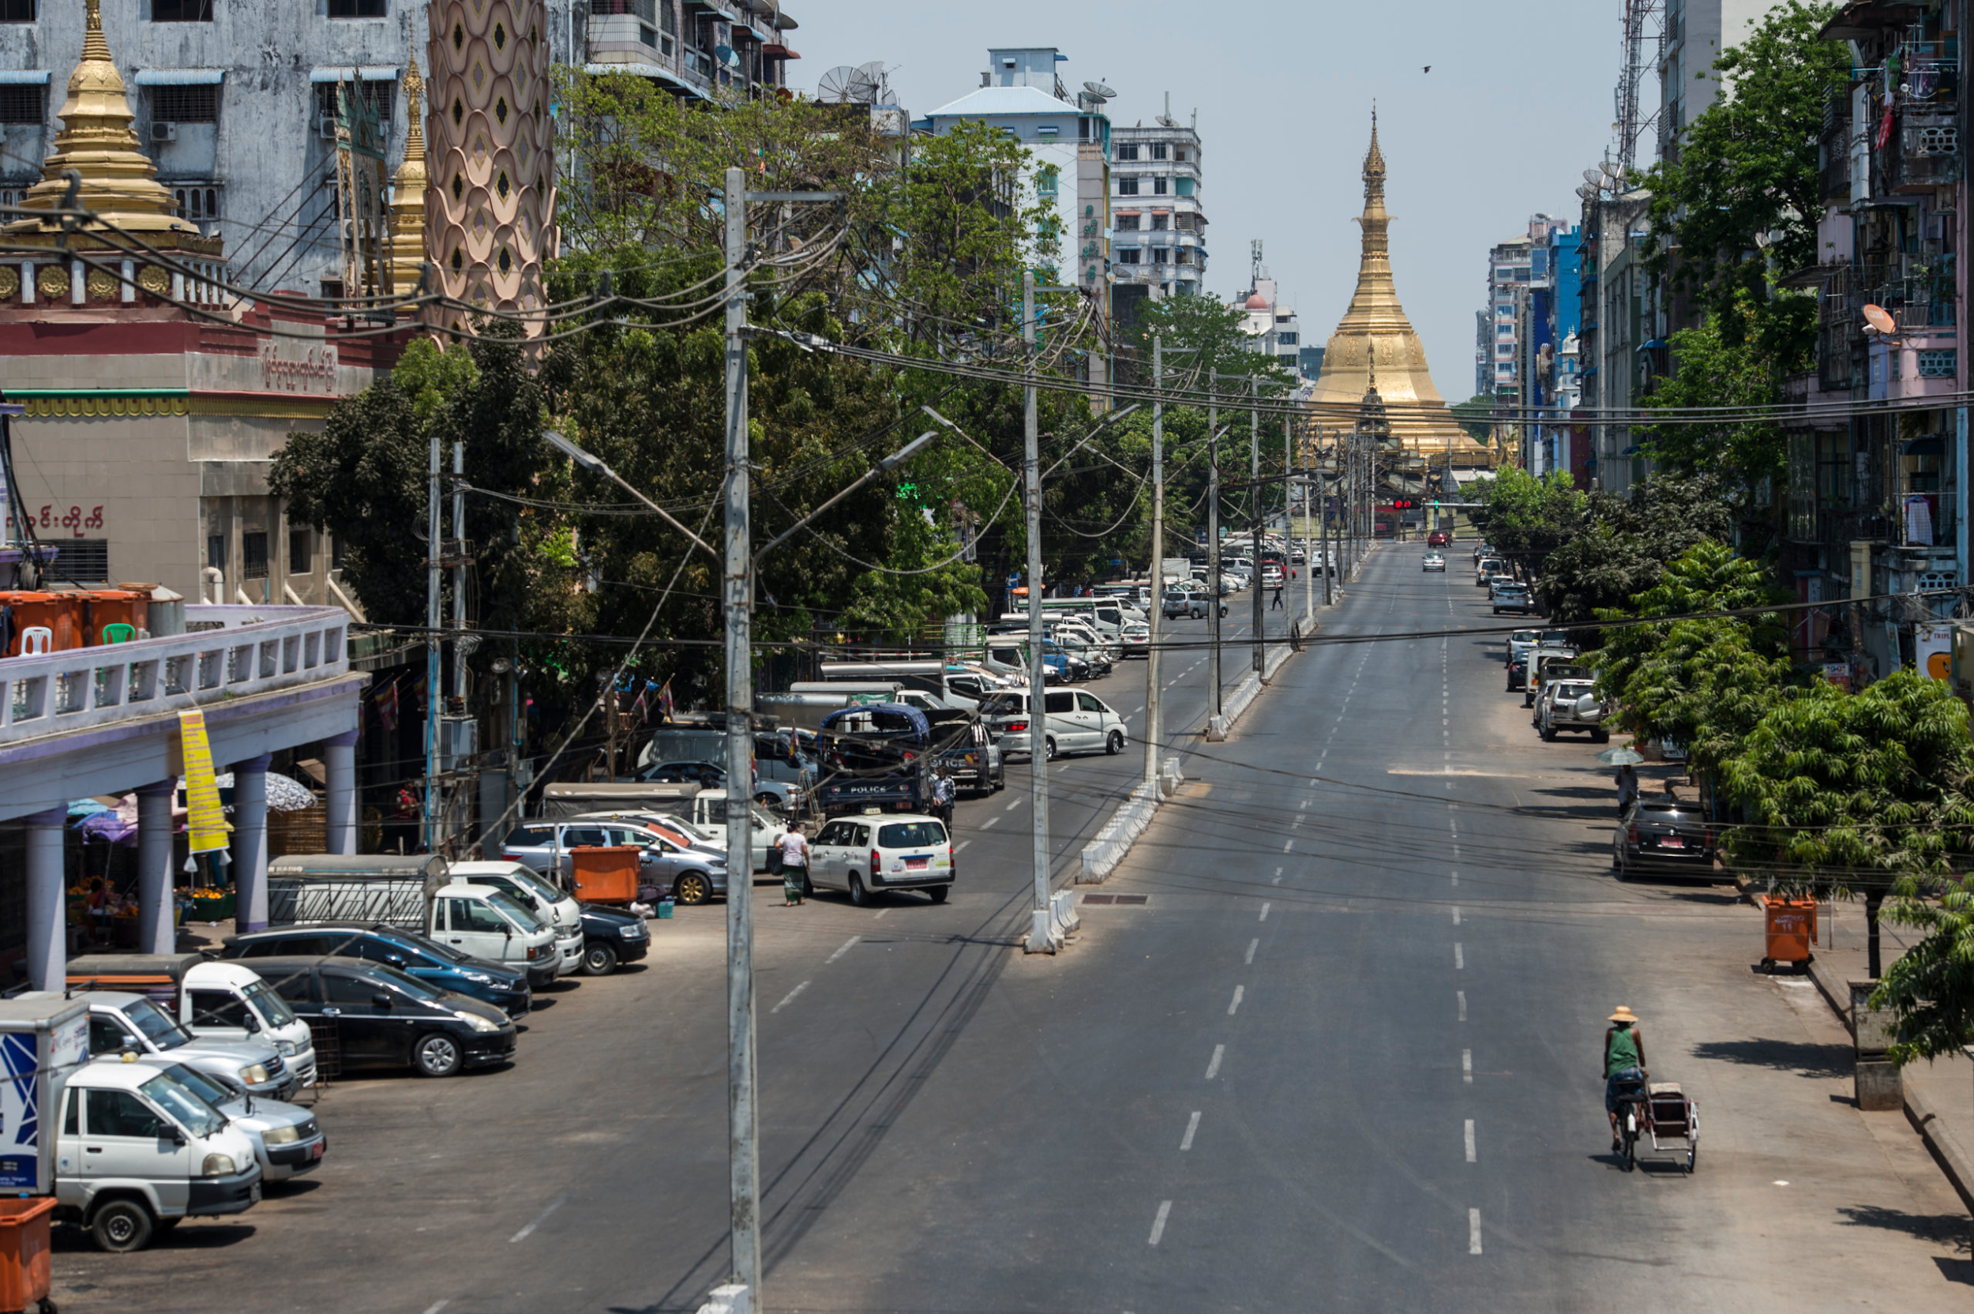
The challenge : Air pollution in Yangon before and during COVID 19
Hypothesis : Yangon air quality is improved during COVID-19.
Before COVID 19
During COVID 19

Slide 4
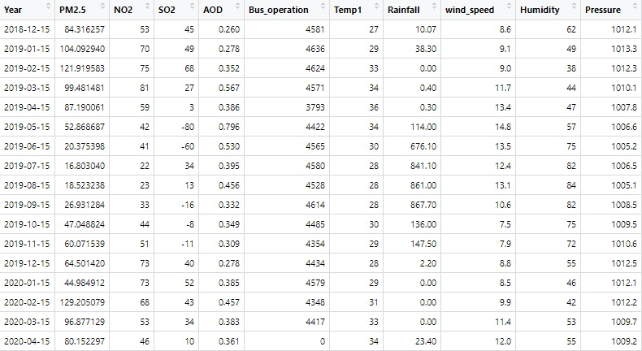
Methodology
Data Set
Analysis
Type of Data | Sources
PM 2.5 (ug/m³) | https://www.purpleair.com/sensorlist?key=Z2EPRT4DC1ZO1TDL&show=9578
Rainfall (mm), Pressure, Wind speed | https://www.worldweatheronline.com/yangon-weather-history/yangon/mm.aspx
Factories | Ministry of Labor
Transport and vehicles | Ministry of Transport
Time series analysis
GIS mapping
Multiple regression analysis

Slide 5
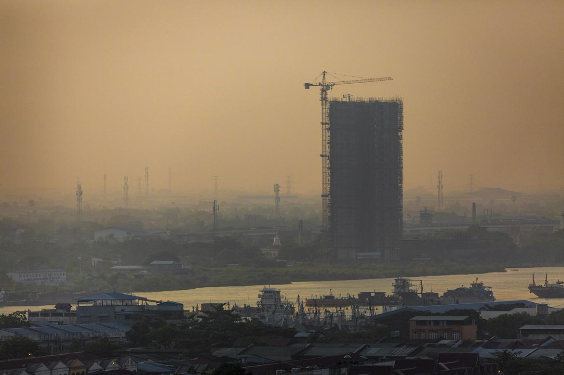
1. South Okkalapa Industrial Zone 2. Dagon Seikkan Industrial Zone (1,2) 3. South Dagon 1 Industrial Zone 4. No-2 South Dagon Industrial Zone 5. South Dagon 3 Industrial Zone 6. Y.C.D.C+North Dagon Industrial Zone 7. North Okkalapa Industrial Zone 8. East Dagon Industrial Zone 9. Shwe Poukkan Industrial Zone 10. Tharkayta Industrial Zone
20 Industrial Zones ( Yangon )
11. Mingalardone Industrial Park 12. Pyin Ma Bin 13. Yangon ( Zaykabar ) 14. Hlaing Tharyar Industrial Zone (1,2,3,4,6,7) 15. Hlaing Tharyar 5 Industrial Zone 16. Shwe Lin Ban Industrial Zone 17. Shwe Pyi Thar (1) Industrial Zone 18. Shwe Pyi Thar(2/3/4)Industrial Zone 19. Myaung Ta Kar Steel Founding Industrial Zone 20. Wartayar Woodbase
According to the Ministry of Labor, there are More than 7000 factories.

Slide 6
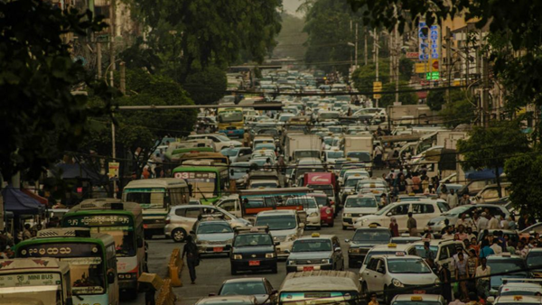
Transport services and vehicles numbers
Yangon more than 1 million Vehicles 4 Type Of Services –
Railways Services
Airlines Services
Maritime Services
Road Transport Services
Ref: Ministry of Transport

Slide 7
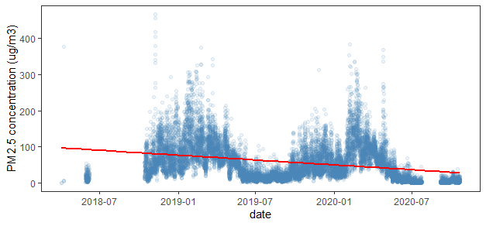
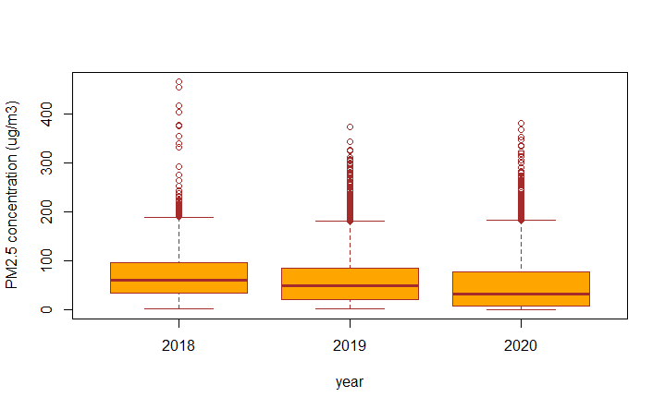
PM2.5 concentration from 2018 (April) to 2020 (October)
A decreasing trend of PM 2.5 concentration
PM2.5 concentration in 2018 is higher than the concentration in 2019 and 2020.
In 2018, data from January to March and July to September are unavailable.
In 2020, August data are missing.

Slide 8
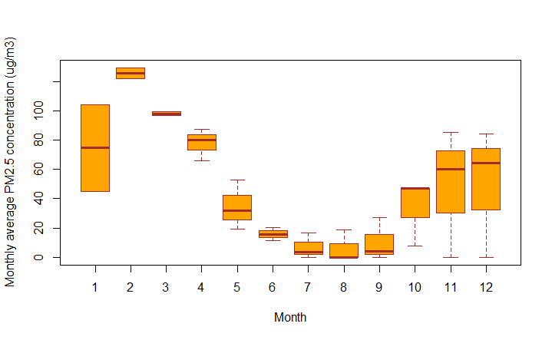
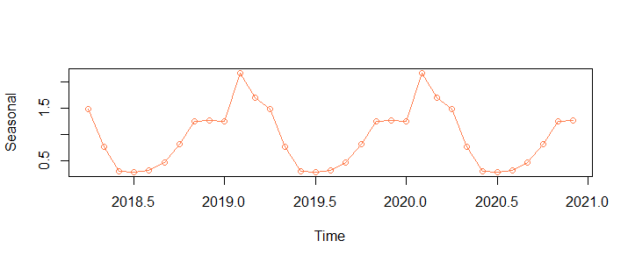
Monthly and seasonal trend of PM2.5 concentration
Monthly : concentration is the highest in February and lowest in August all year round
Seasonal : decreasing in May and increasing back in February

Slide 9
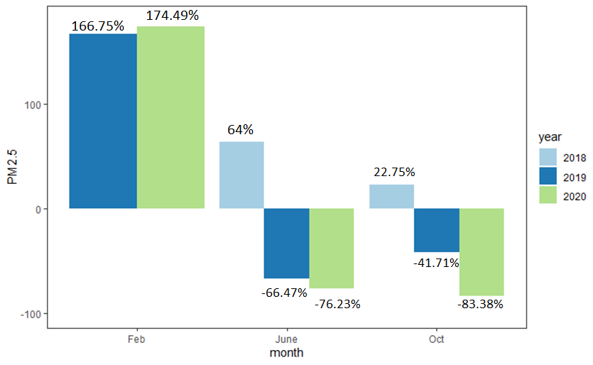
PM2.5 decreased in 2020
In 2020 June, the periods of COVID lock down times, PM2.5 concentration decreased by 76.23% whereas in 2018 it increased to 64% and decreased by 66.47% in 2019.
In October 2020, the concentration decreased to 83.38% and this was 2 times lesser than October 2019.

Slide 10
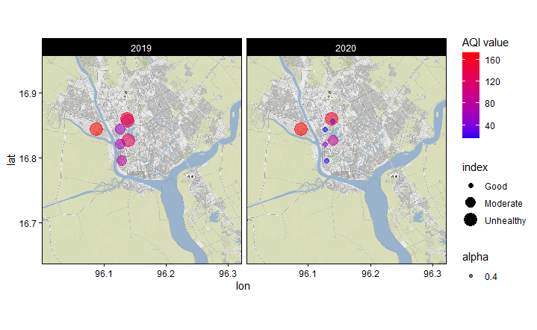
Improved air quality near 7 mile in 2020
In 2019, air quality was moderate and unhealthy status.
In 2020, air quality improved to good condition.

Slide 11
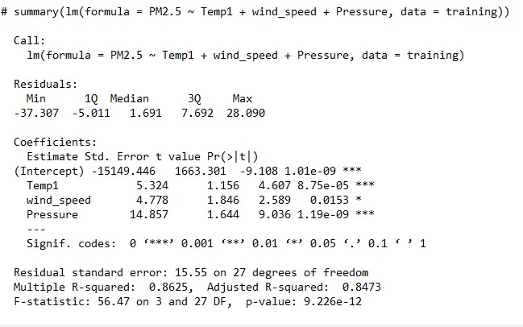
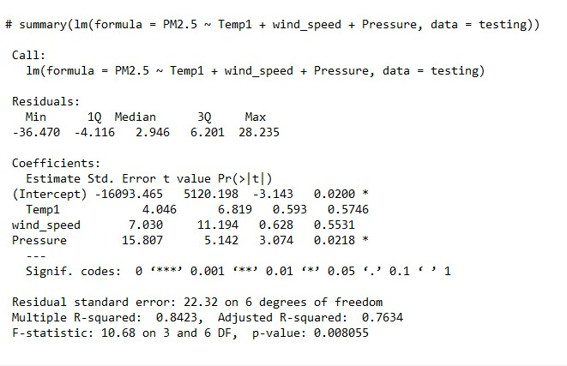
Multiple Regression Model on PM2.5

Slide 12
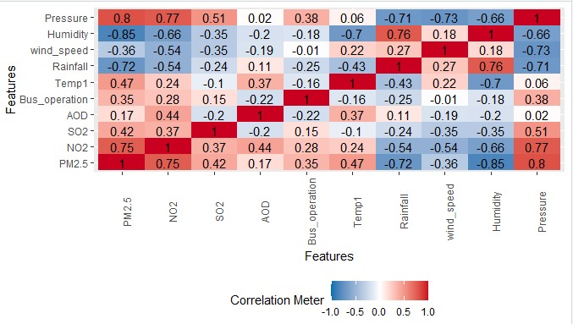
Correlation Chart
Pearson’s correlation coefficient (linear correlation): shows linear correlation between two continuous variables.
Bus operation, temperature , and atmospheric pressure was found to be significant factors compared to others influencing PM2.5.
Increase of rainfall and humidity, wind speed has negative correlation with PM2.5 concentration.

Slide 13
Regression model results
The model establishes influence of meteorological conditions like temperature, rainfall, humidity, atmospheric pressure, with elemental concentrations of PM2.5 in Yangon .
Pearson’s coefficient of correlation was applied to study the association between PM2.5 and meteorological variables.
Bus operation , temperature ,wind speed and atmospheric pressure was found to be significant factors compared to others influencing PM2.5.
Increase of rainfall and humidity has negative correlation with average PM2.5 concentration.
The study also infers that the wind speed and atmospheric pressure inducing increment of average PM2.5 concentration in Yangon.

Slide 14
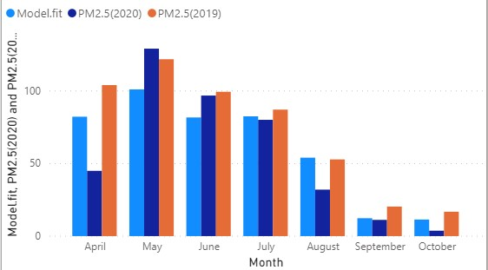
Comparison of Regression Model’s Results and Actual Data
Compare the predicted results from model with 2019 and 2020 data.
In 2020 July and September,PM2.5 concentration is slightly decreased than predicted value.
In 2020 October, PM2.5 concentration is the lowest between predicted and 2019 data.

Slide 15
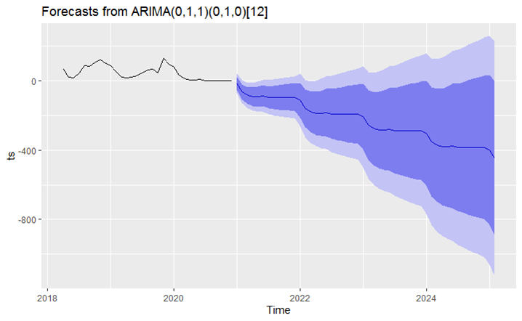
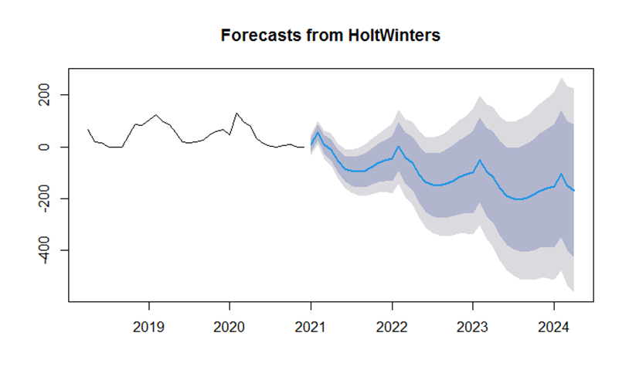
Forecasting PM2.5 concentration for next 4 years

Slide 16
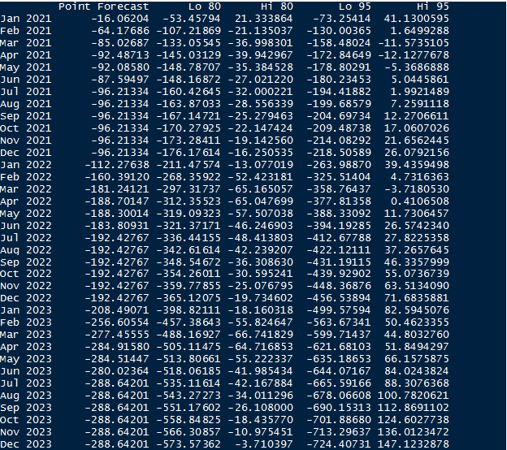
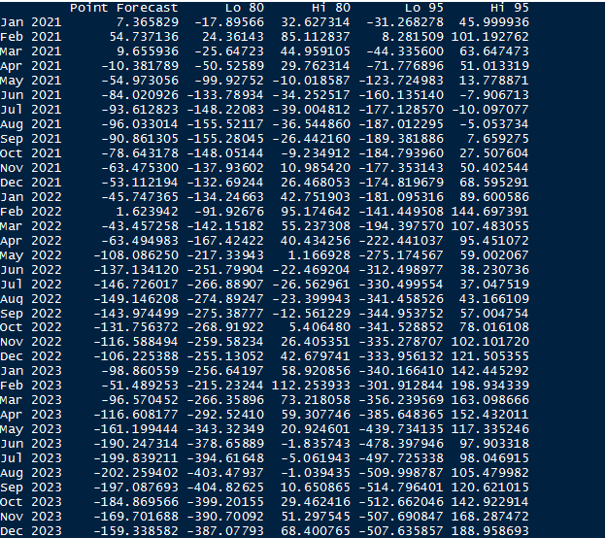
PM2.5 forecasted values
ARIMA model
HoltWinters model

Slide 17
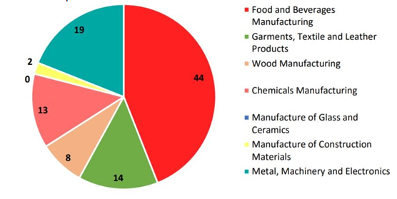
Discussion
Air pollution has decreased during COVID-19 due to temporary shutdown of factories and vehicles commutes.
40% of all sectors temporarily shut down

Slide 18
Discussion
According to ARIMA and HoltWinters models, there is a downward trend of PM2.5 concentration for future years.
However, the models may be biased due to the historical data is missing for some months.
In addition, two and a half years is a very short historical data to train an accurate model and obtain correct predicted values.

Slide 19
Conclusion
PM2.5 concentration decreased in 2020 and this made Yangon air quality improve.
Multivariate regression model shows that meteorological factors has a significant effect on PM2.5 concentration.
ARIMA model and HoltWinters model forecasted decreasing trend of PM2.5 concentration for 4 years ahead.
Data analysis visualizations are useful for air quality controller and environmental monitoring.
GIS mapping is a spatial visualization which shows different air quality across different places.

Slide 20
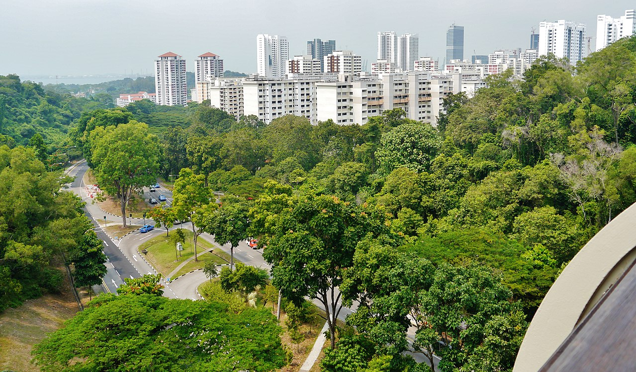
Let’s Make Yangon Greener and Cleaner
Thank You!

